Slide 1


Slide 2


Slide 3



Slide 4
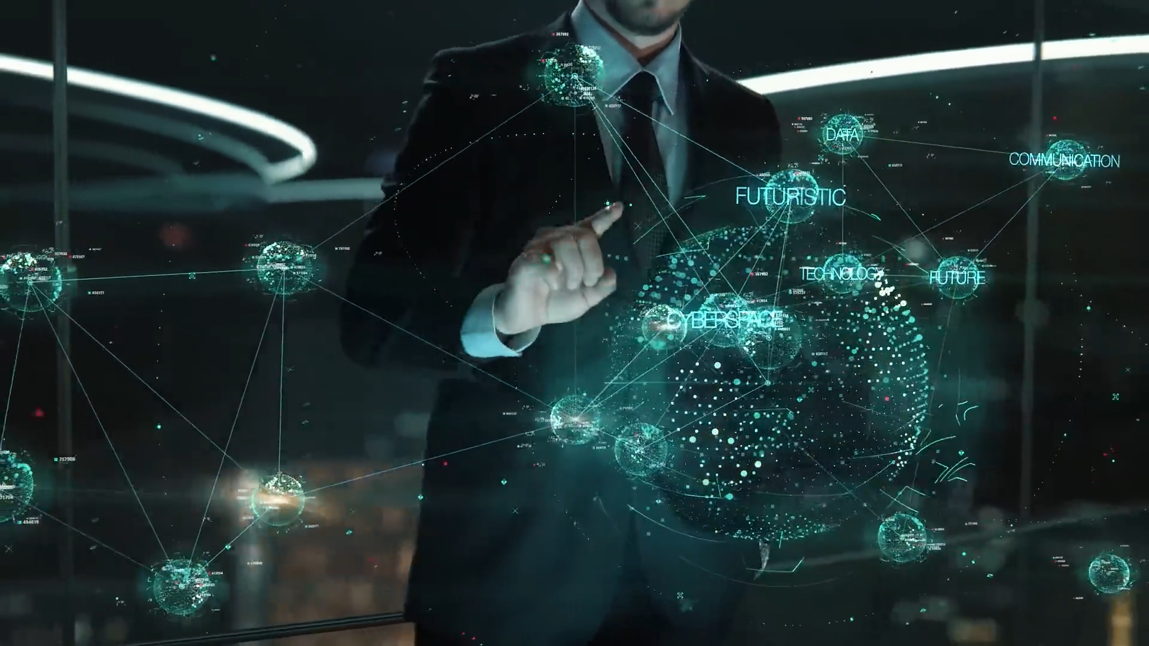

Slide 5

01
INTRODUCTION TO AI
HISTORY AND EVOLUTION OF AI
TABLE OF
CONTENTS
02
WHY DO WE NEED THEM
03
WHERE ARE THEY USED
04
05
ADVANTAGE OF AI
07
CONCLUSION

Slide 6
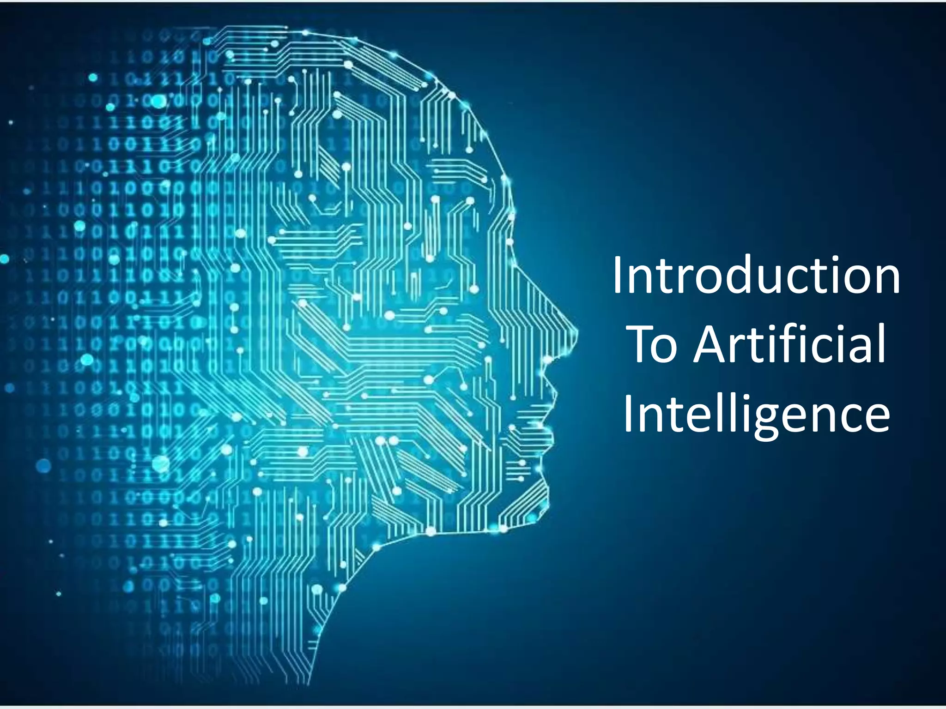
INTRODUCTION TO AI
AI stands for Artificial Intelligence.
It enables machines to learn, understand, and make decisions.
AI tries to perform tasks that normally require human intelligence Examples: ChatGPT, Google Maps, Face Recognition, Voice Assistants.
AI is becoming an important part of modern technology and computer science.

Slide 7
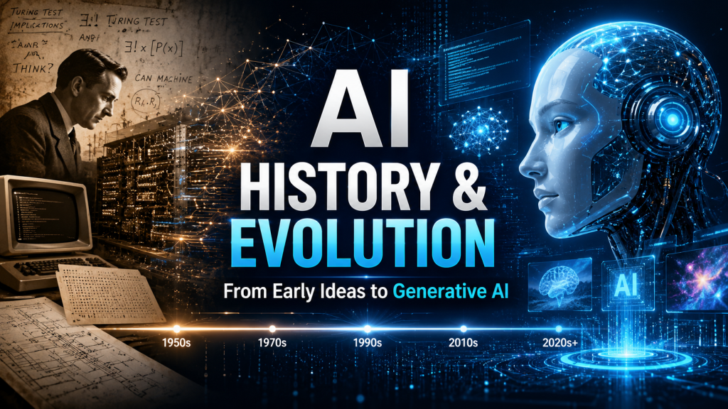
1940s–50s → Beginning of AI Early research focused on machines that could solve problems .
Alan Turing introduced the idea of testing machine intelligence.
1956 → Birth of AI The term Artificial Intelligence was introduced at the Dartmouth Conference .
John McCarthy is known as the father of AI.1980s–2000s → Growth Expert systems and machine learning became popular.

Slide 8
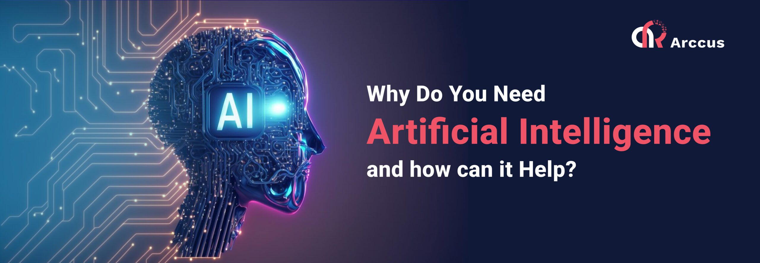
WHY DO WE NEED AI
1.AI helps us to Automate repetitive tasks.
2. Process and analyze large amounts of data.
3. Make faster and data-based decisions.
4. Reduce human errors.
5. Solve complex problem.
6. Provide personalize experiences.
7. Improve productivity in different industries.

Slide 9
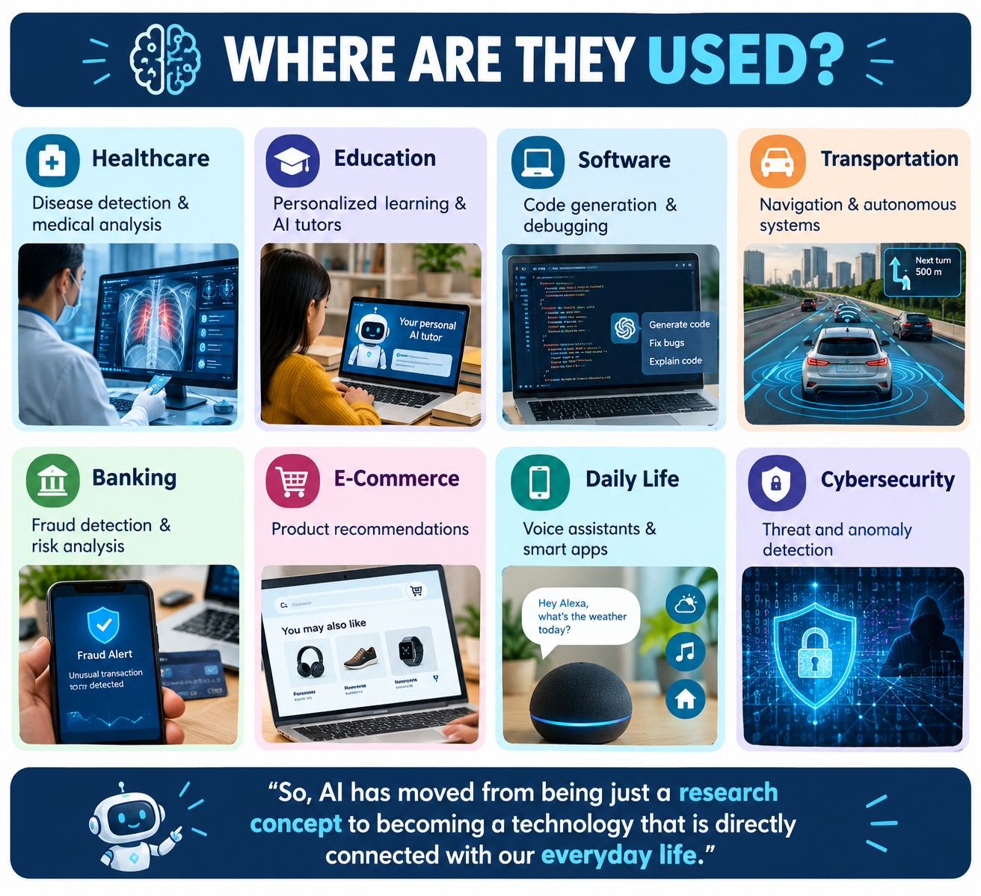
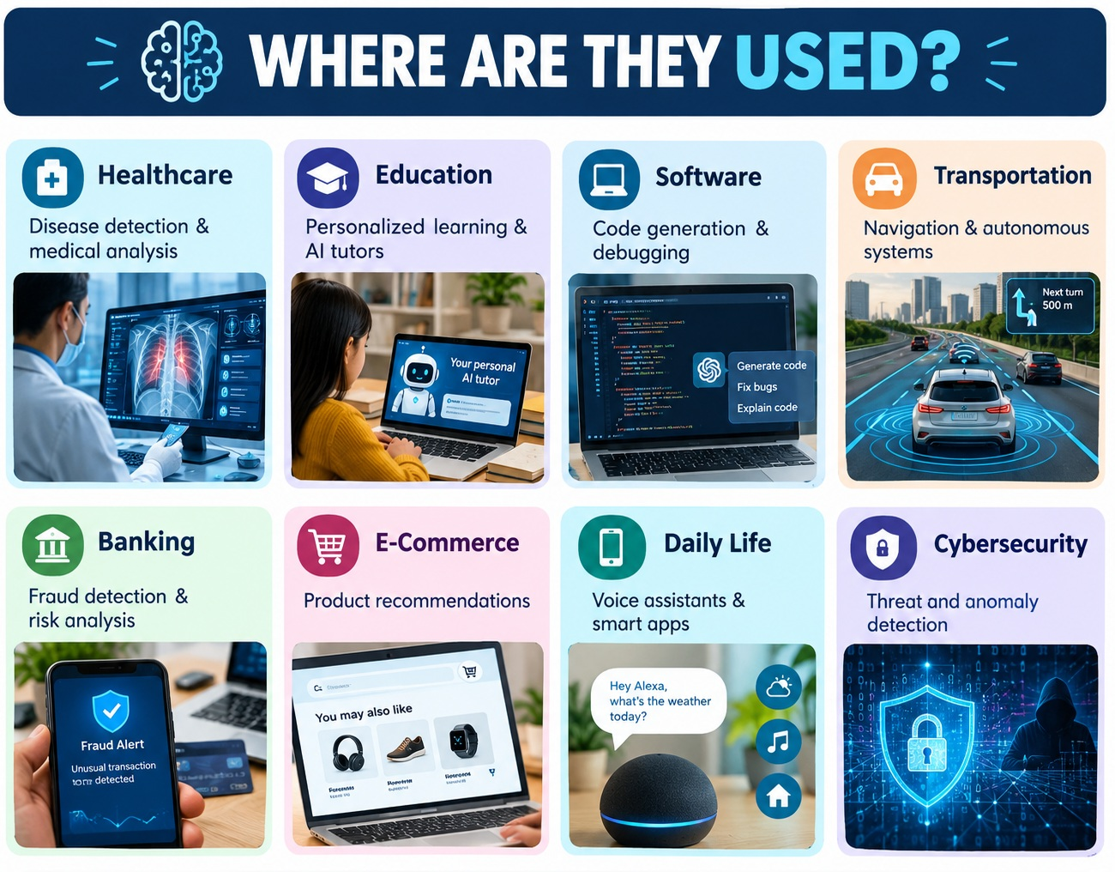

Slide 10
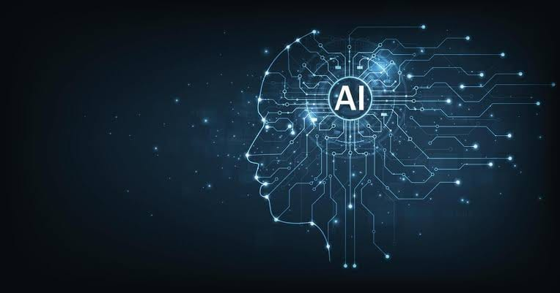
ADVANTAGES OF AI
1.Saves Time – Completes tasks quickly.
2. Improves Accuracy – Reduces human errors.
3.Automates Work – Handles repetitive tasks.
4. Analyzes Data – Processes huge data quickly.
5.Helps Healthcare – Supports disease detection.
6. Supports Education – Enables personalized learning

Slide 11

CONCLUSION OF AI
4.AI DRIVES INNOVATION AND NEW OPPORTUNITIES
3.AI HELPS HUMAN SOLVE COMPLEX PROBLEMS.
5.AI SHOULD BE USED SAFELY AND RESPONSIBLY.
2.AI SAVES TIME AND IMPROVES PRODUCTIVITY
6.AI WILL PLAY AN IMPORTANT ROLE IN THE FUTURE.
1.AI IS TRANSFORMING OUR DAILY LIVES.

Slide 12

THANK YOU

